Slide 1

Name:
Arash Harirpoosh
Student Number:
9731505
Presentation Title:
CoAP Comparison

Slide 2
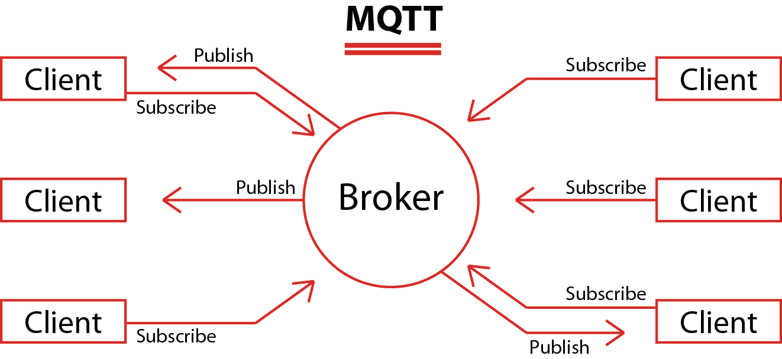
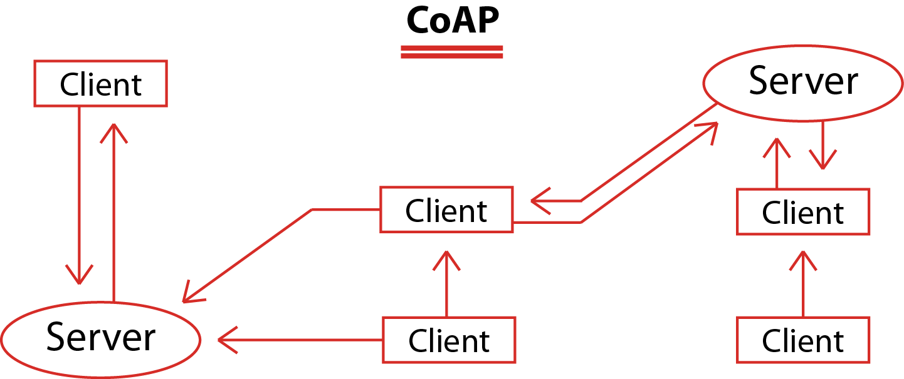
CoAP vs MQTT
Architecture
MQTT
MQTT is publish/subscribe messaging protocol
Every message publish to an address, known as topic
Clients may subscribe to multiple topics
Runs over TCP
M:N communication
CoAP
Follows client/server model
Clients make requests to servers, servers send back responses
Clients may GET, PUT, POST and DELETE resources.
1:1 comunication

Slide 3
CoAP vs MQTT
Security
MQTT
May require username and password authentication
To ensure privacy, the TCP connection may be encrypted with SSL/TLS
CoAP
Because it is built on top of UDP not TCP, SSL/TLS are not available.
Instead use DTLS or IPSec

Slide 4
CoAP vs MQTT
Power Consumption
MQTT Used more power than CoAP
Packet size
MQTT has 2 Bytes header
CoAP has 4 Bytes header
Quality of service
CoAP
Confirmable, Non-confirmable, Acknowledgment and Reset messages
MQTT
QoS levels in fixed headers(QoS0, QoS1, QoS2)

Slide 5
References
https://www.eclipse.org/community/eclipse_newsletter/2014/february/article2.php
https://www.pickdata.net/news/mqtt-vs-coap-best-iot-protocol
https://datatracker.ietf.org/meeting/103/materials/slides-103-maprg-evaluating-the-performance-of-coap-mqtt-and-http-in-vehicular-scenarios-jaime-jimenez-00
Lecture-05v2.pdf

